Slide 1
Aslam-o-Alaikum 🙋 Namastey 🙏 RADHE RADHE ♥

Slide 2


Magnetic Field an abstract sphere
NORTH
South
Permanent Magnet
S
N

Slide 3
Be a ethical listener
Listen carefully before asking question

Slide 4
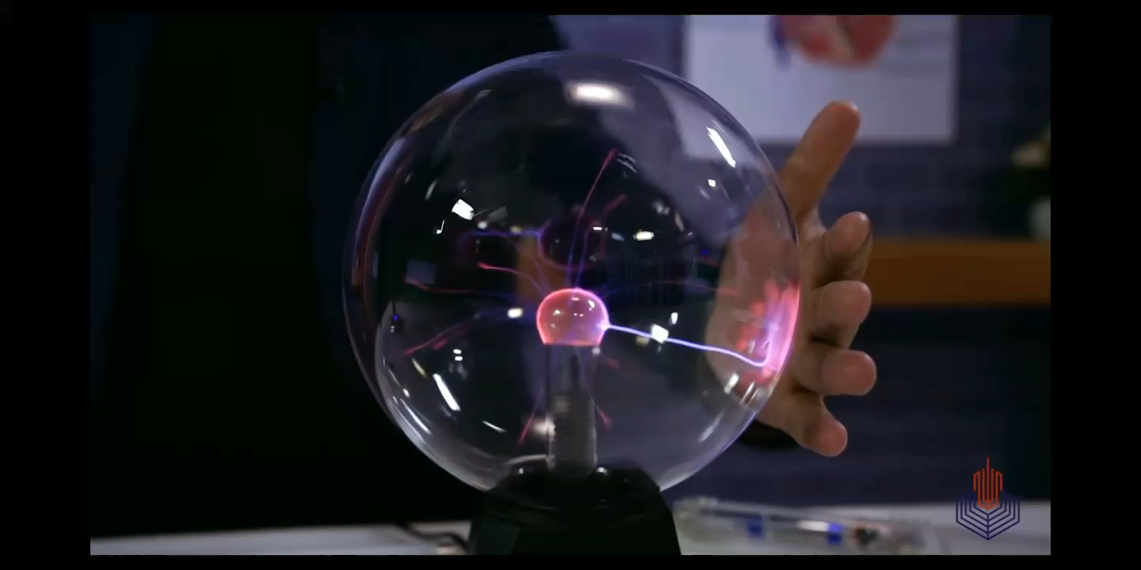
Before moving towards magnetic field, let’s see an example of electric field

Slide 5
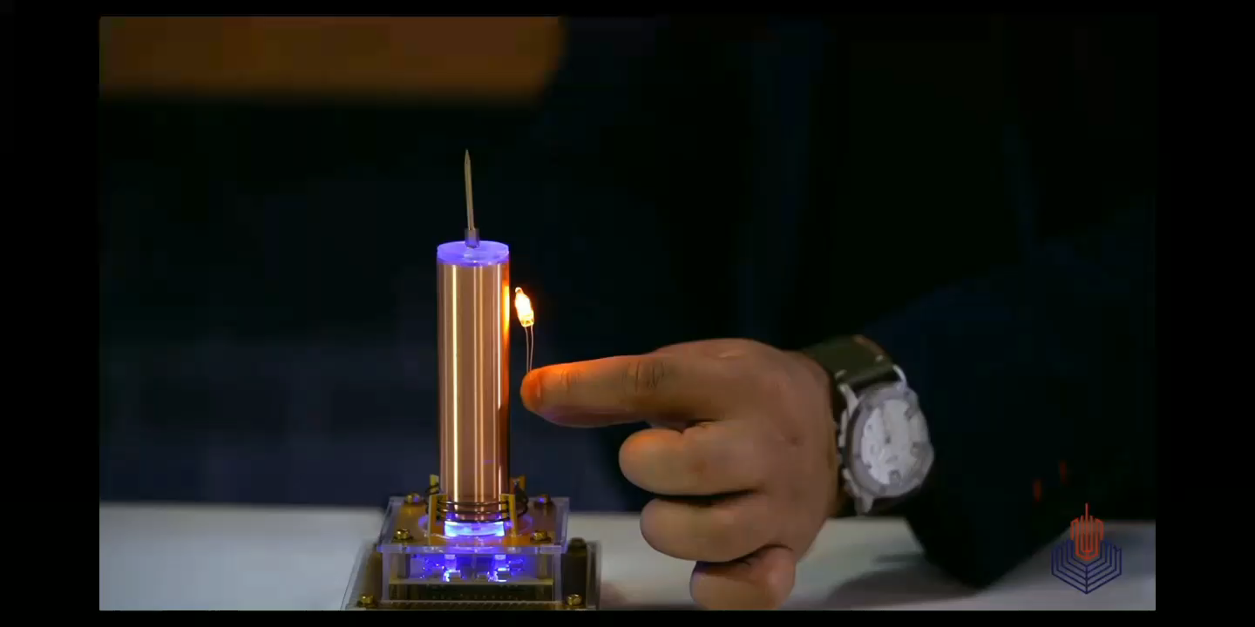
Tesla Technology

Slide 6
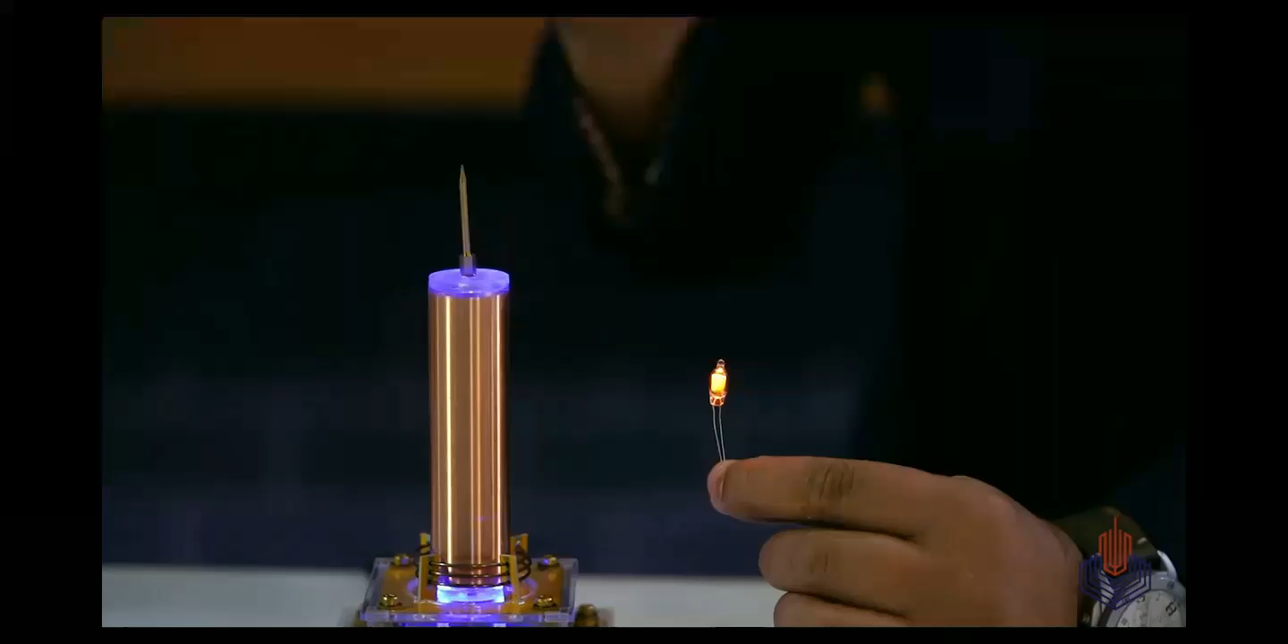
Tesla Technology

Slide 7
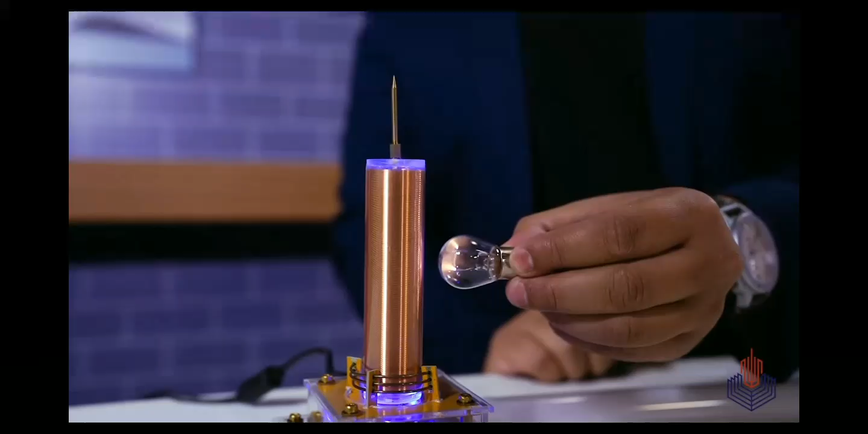
Electrons are being ejected from bulb light.

Slide 8
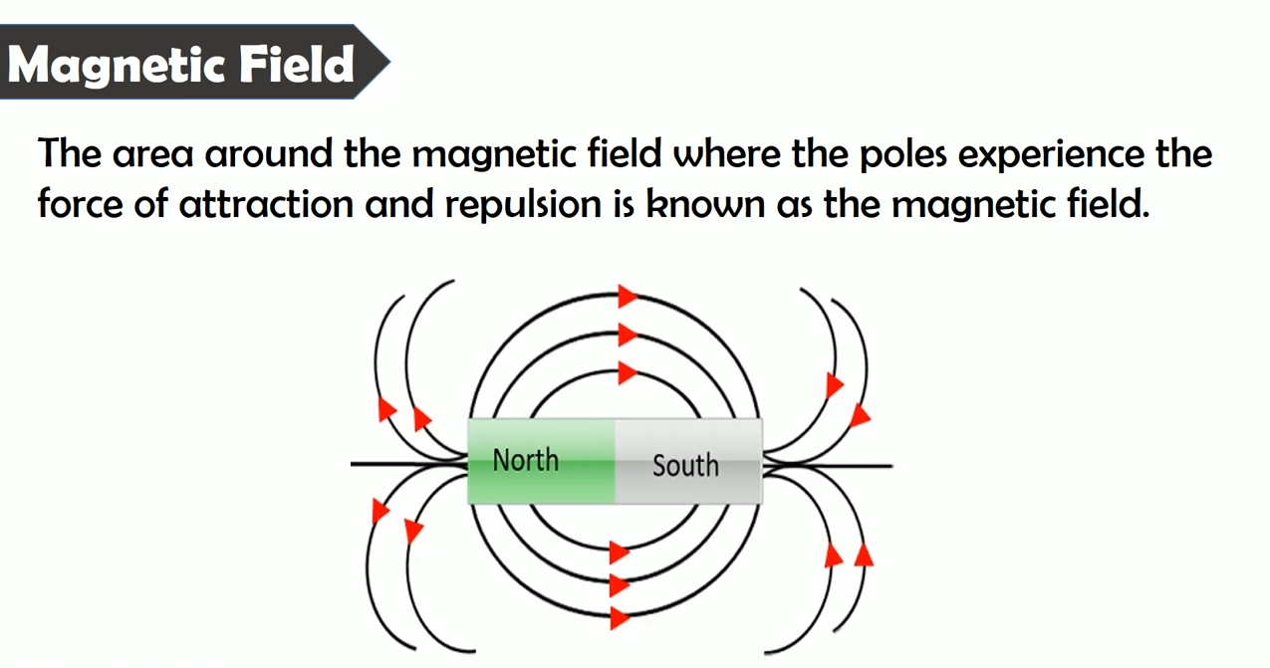
N

Slide 9
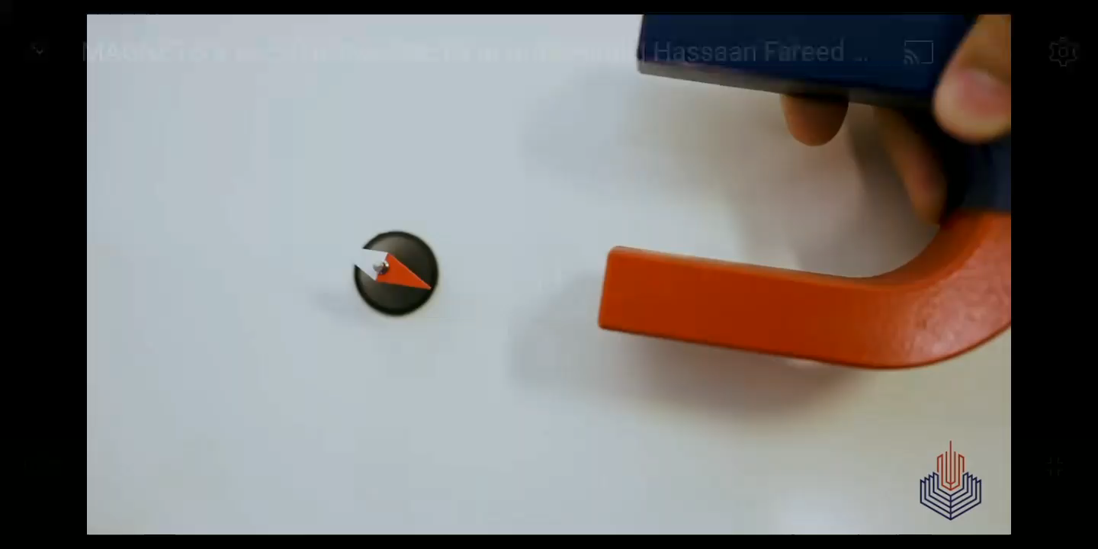
Existing of Magnetic Field

Slide 10
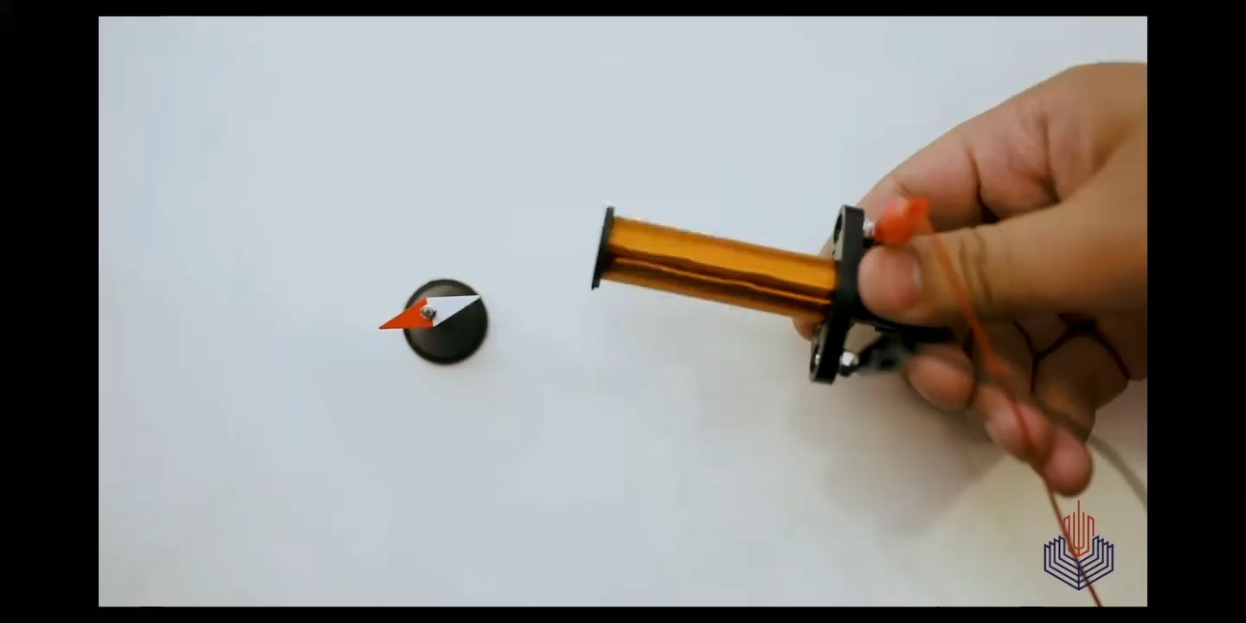
Existing of Magnetic Field

Slide 11
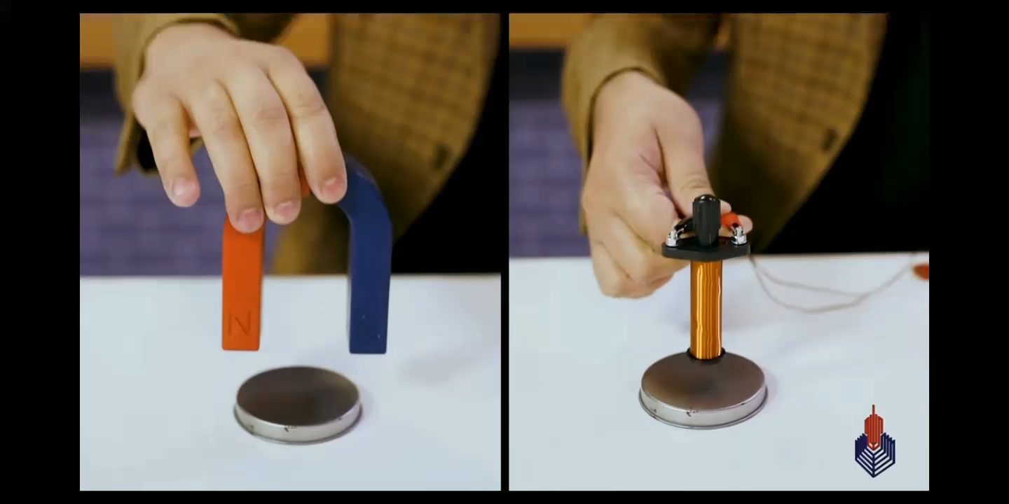
Existing of Magnetic Field

Slide 12
Properties of Magnetic Field
1. Direction: direction of magnetic field lines
2. Loop
3. Path
4. Intersection

Slide 13
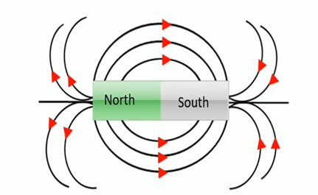
Direction
1. Direction: direction of magnetic field lines
Outside : north to south
inside : south to north
Magnetic
Field lines
Magnetic
Field lines
Horizontal bar line

Slide 14

LOOP
2. Loop : The Magnetic field lines always form a closed loop.

Slide 15
Path
3. Path : Attraction/repulsion is possible in the path of magnetic field.
Outside Magnetic field
Inside Magnetic field
repulsion
attraction
Neither attraction nor repulsion

Slide 16
Intersection
4. Intersection : The magnetic field lines never intersect each other they always try to repel each other.
repulsion
repulsion

Slide 17
Bar Magnet
N
S

Slide 18
Between bar magnets attraction or repulsion ?
N
S
S
N

Slide 19
Between bar magnets attraction or repulsion ?
N
S
N
S

Slide 20
Permanent Magnet VS Electro Magnet
1. permanent Magnet : The Magnetic field always exist never ends.
: Magnetic field can’t be off.
2. Electro Magnet : Magnetic field does not exist always, it depends upon electric current.
: magnetic field exists when current is available.

Slide 21
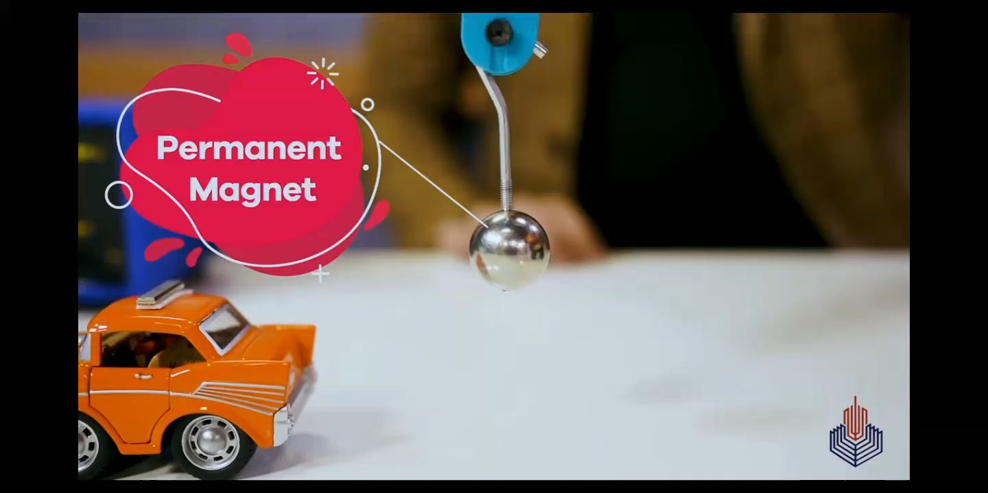
Permanent Magnet

Slide 22

Electro Magnet

